Slide 1


Rotary screw trap Passage Estimation “RST_app”
July 21st, 2026

Slide 2
Outline
Why a new passage application?
Demo RST_app:
https://arthurbarros-cdfw.shinyapps.io/RST_app/
RST_app overview and updates
Data inputs and formatting.
Application functions and flow.
Catch and efficiency model fitting.
Incorporating discharge as an environmental covariate.
Future updates and next steps
GitHub: https://github.com/arthurbarros-CDFW/RST_app

Slide 3
Why a new application?
Last years outmigrant monitoring survey/poll.
Inventory of outmigrant monitoring methods and protocols.
Develop a repository of documentation and guidance for current and future outmigrant surveys.
Provide statistical support where necessary.
Better understand how folks where estimating outmigrant passage.
CAMPR and DARR

Slide 4
Why a new application?
CAMPR:
Estimates RST juvenile passage from user catch, efficiency trial, and visit data.
Requires users to utilize and maintain a back-end access database.
Complex “black-box” lacking detailed documentation and control.
Created in 2011, last updated in 2022, no longer maintained.

Slide 5
Why a new application?
RST_app:
Standalone RShiny application that performs model fitting and outputs passage estimation tables and plots.
Web based application does not require R or MS Access.
Requires users to pre-format RST catch and efficiency trial data.
Provide detailed documentation on functionality and usage.
Support and updates provided by Fisheries Branch biostatistician (me).

Slide 6
Demo application
https://arthurbarros-cdfw.shinyapps.io/RST_app/

Slide 7
Data inputs and formatting
Four required data sets:
catch – records of fish caught during each trap visit.
visit – records of all trap operation and enviornmental covariates.
release – records of fish marked and released for efficiency trials.
recapture – records of marked fish recaptured for efficiency trials.
Each table must be properly formatted, see RST_app user guide.
Example data: https://github.com/arthurbarros-CDFW/RST_app/tree/main/data/test_data

Slide 8

App functions and flow
Data Inputs
catch_data
visit_data
release_data
recapture_data
Outputs
passage_estimates
efficiency_results
catch_results
summary plots
est_passage.R
User Inputs
summarize.by
impute_all
survey_start
survey_end
passage_boot.R
summarize_passage.R
est_catch.R
calculate_sampling_time.R
fix_dates.R
assign_batch_date.R
est_efficiency.R
find_visits_near_release.R
model_catch.R
model_efficiency.R
summarize_index.R

Slide 9

App functions and flow
Data Inputs
catch_data
visit_data
release_data
recapture_data
Outputs
passage_estimates
efficiency_results
catch_results
summary plots
app.R
est_passage.R
User Inputs
summarize.by
impute_all
survey_start
survey_end
Include_discharge
passage_boot.R
summarize_passage.R
est_catch.R
calculate_sampling_time.R
fix_dates.R
assign_batch_date.R
compare_efficiency_models.R
find_visits_near_release.R
model_catch.R
impute_efficiency.R
summarize_index.R

Slide 10
Data Inputs
catch_data
visit_data
release_data
recapture_data
1) Upload data and user inputs
3) Estimate passage
impute_efficiency.R
User Inputs
summarize.by
impute_all
target_species
target_run
survey_start
survey_end
include_discharge
minimum_sample
app.R
Outputs
passage_estimates
efficiency_results
catch_results
summary plots
est_passage.R
2) Run model comparison
est_catch.R
compare_efficiency_models.R
passage_boot.R
model_catch.R

Slide 11
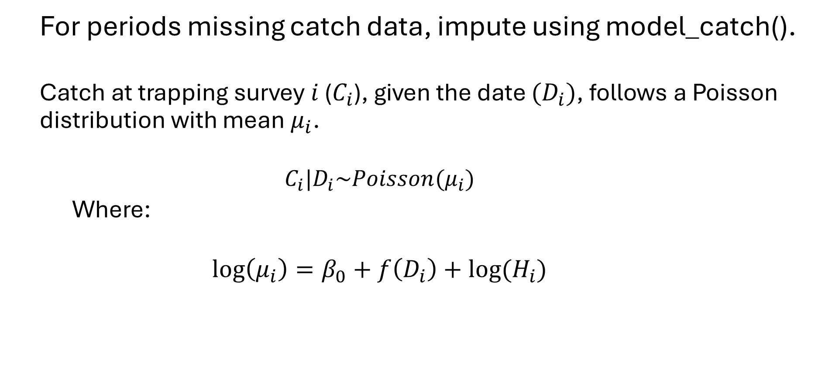
Catch model fitting (model_catch.R)
For periods missing catch data, impute using model_catch().
Catch at trapping survey $i$ ($C_{i}$), given the date ${(D}_{i})$, follows a Poisson distribution with mean $μ_{i}$.
$$C_{i}|D_{i}\sim Poisson(μ_{i})$$
Where:
$$\log\left(μ_{i}\right)=β_{0}+f\left(D_{i}\right)+log⁡(H_{i})$$
Smoother function of date
Offset based on hours sampled

Slide 12
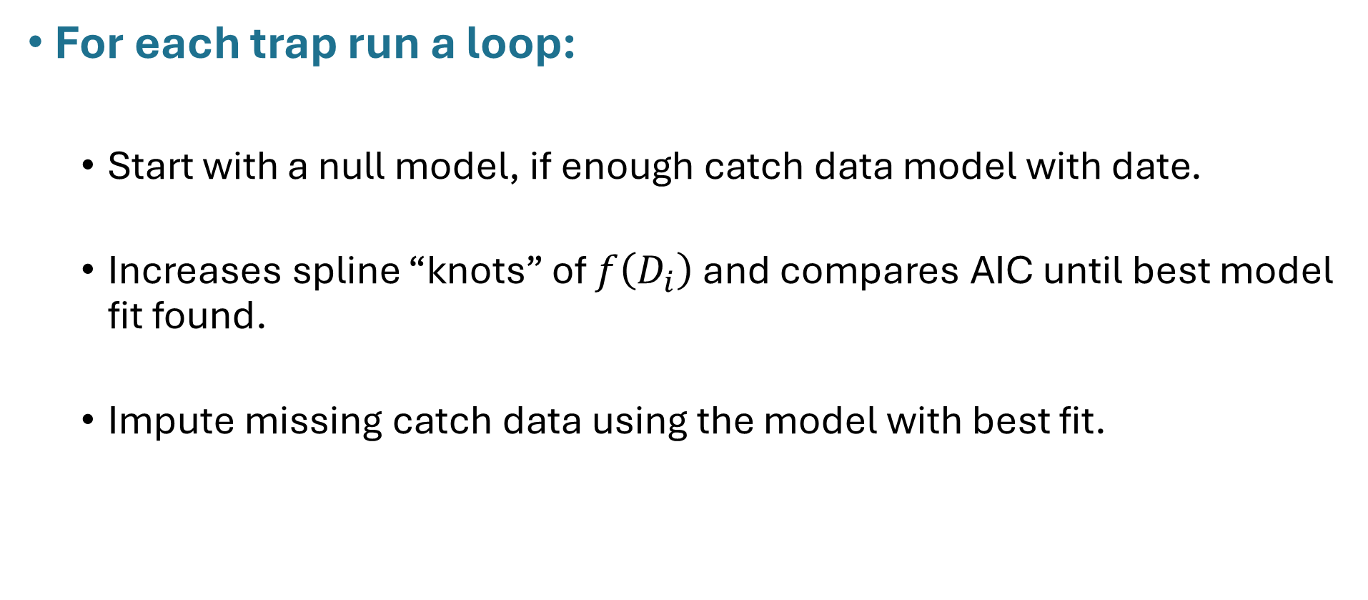
Catch model fitting (model_catch.R)
For each trap run a loop:
Start with a null model, if enough catch data model with date.
Increases spline “knots” of $f\left(D_{i}\right)$ and compares AIC until best model fit found.
Impute missing catch data using the model with best fit.

Slide 13
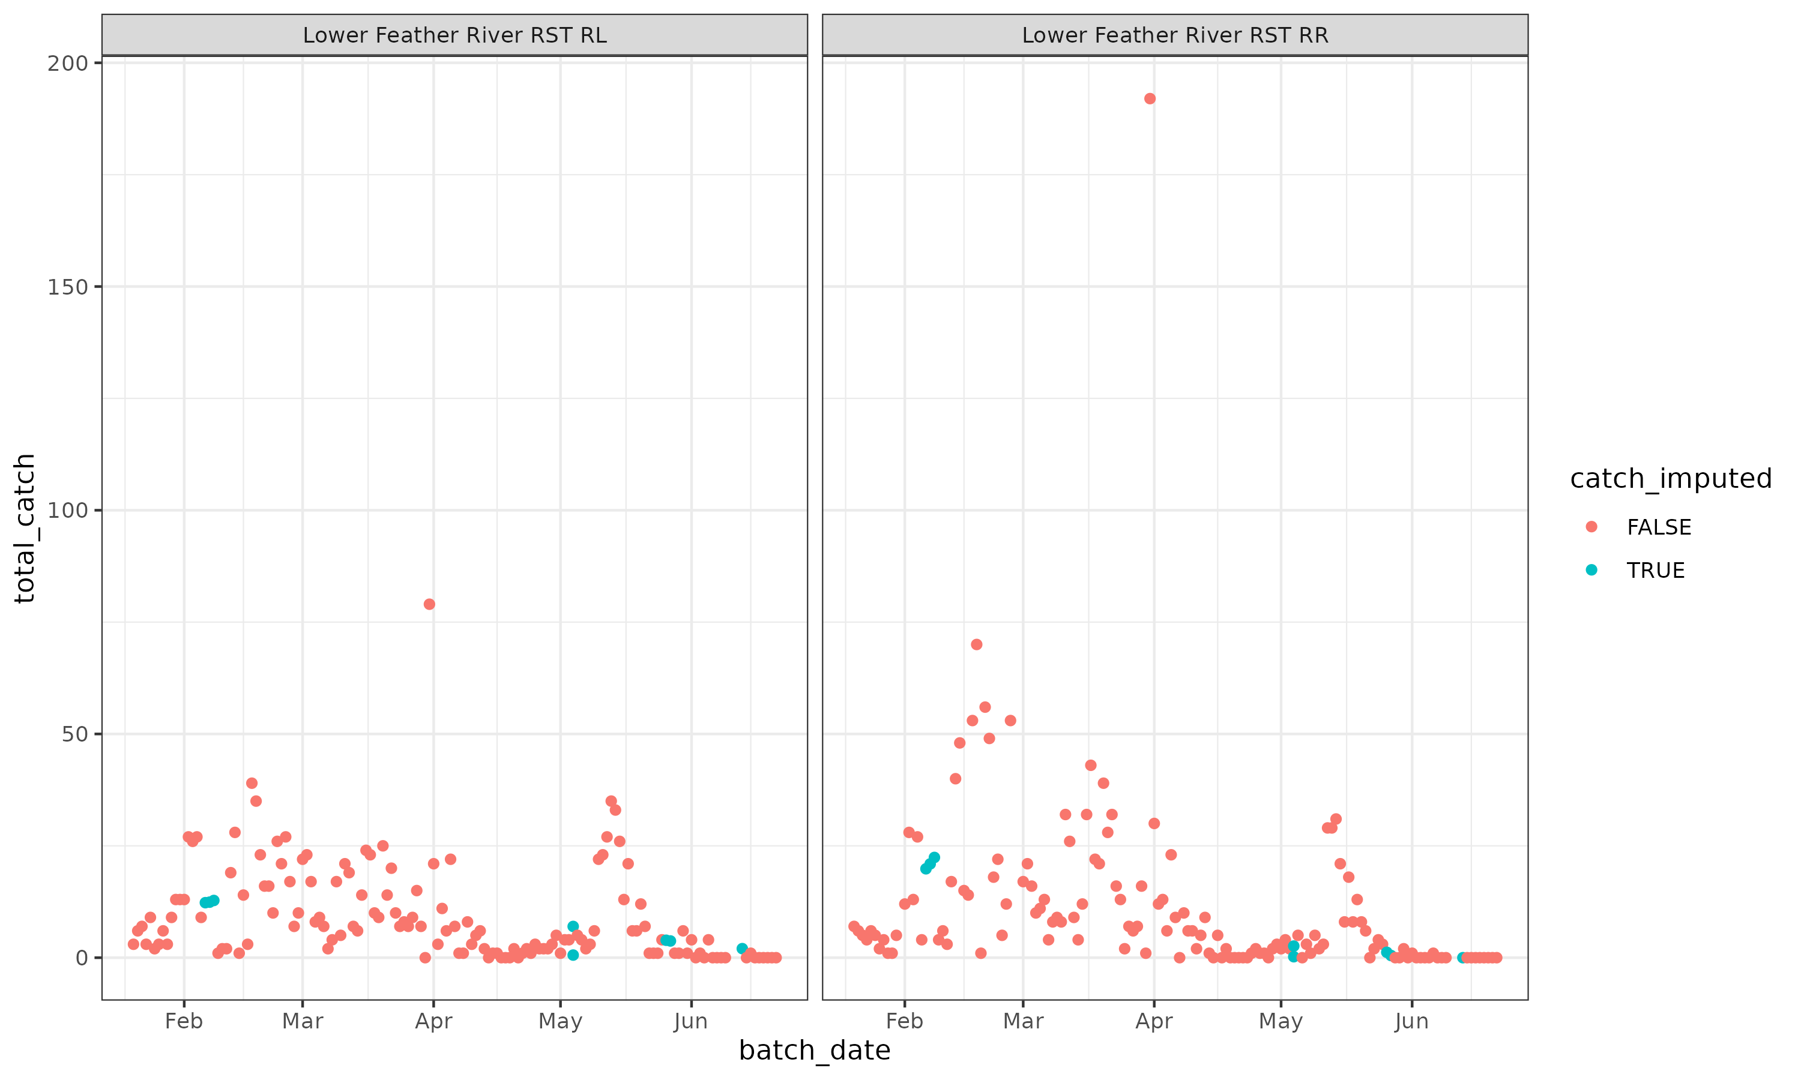

Slide 14
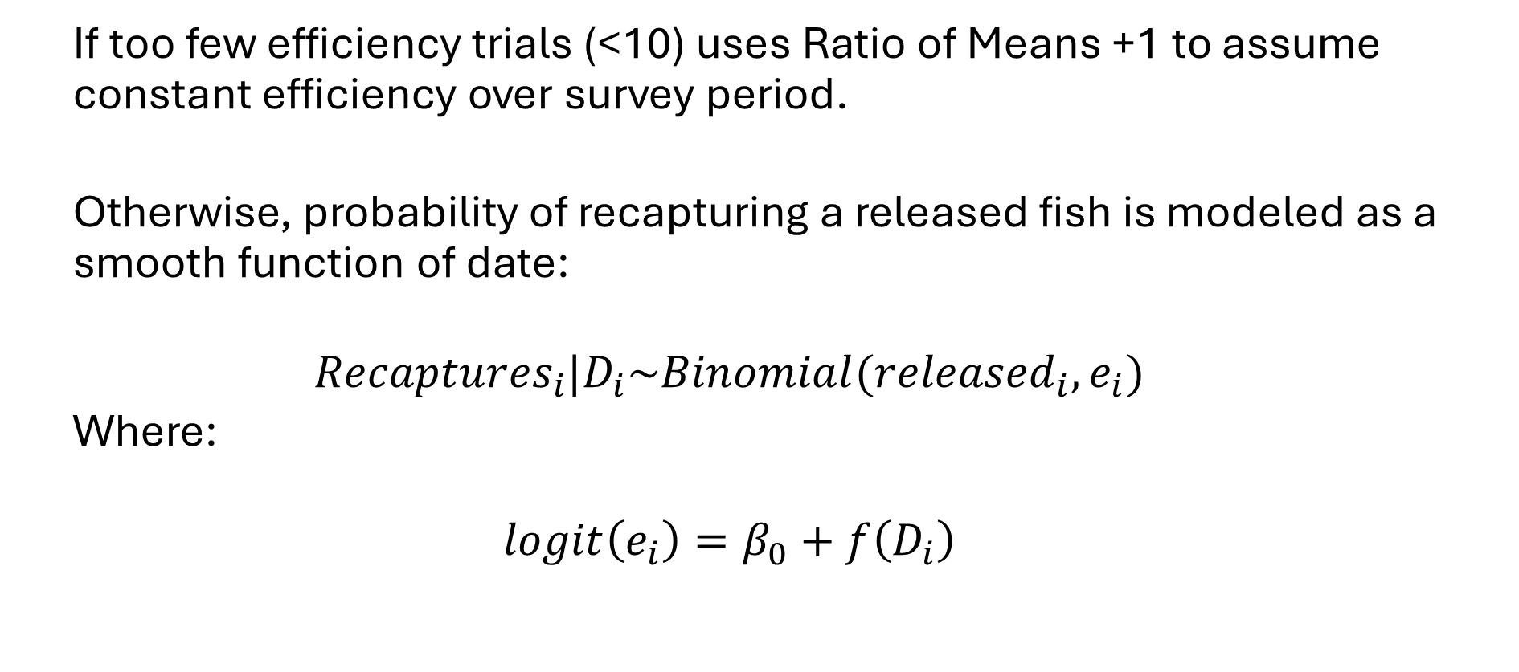
Efficiency model fitting (model_efficiency.R)
If too few efficiency trials (<10) uses Ratio of Means +1 to assume constant efficiency over survey period.
Otherwise, probability of recapturing a released fish is modeled as a smooth function of date:
$${Recaptures}_{i}|D_{i}\sim Binomial({{released}_{i},e}_{i})$$
Where:
$$\operatorname{logit}\left(e_{i}\right)=β_{0}+f\left(D_{i}\right)$$

Slide 15
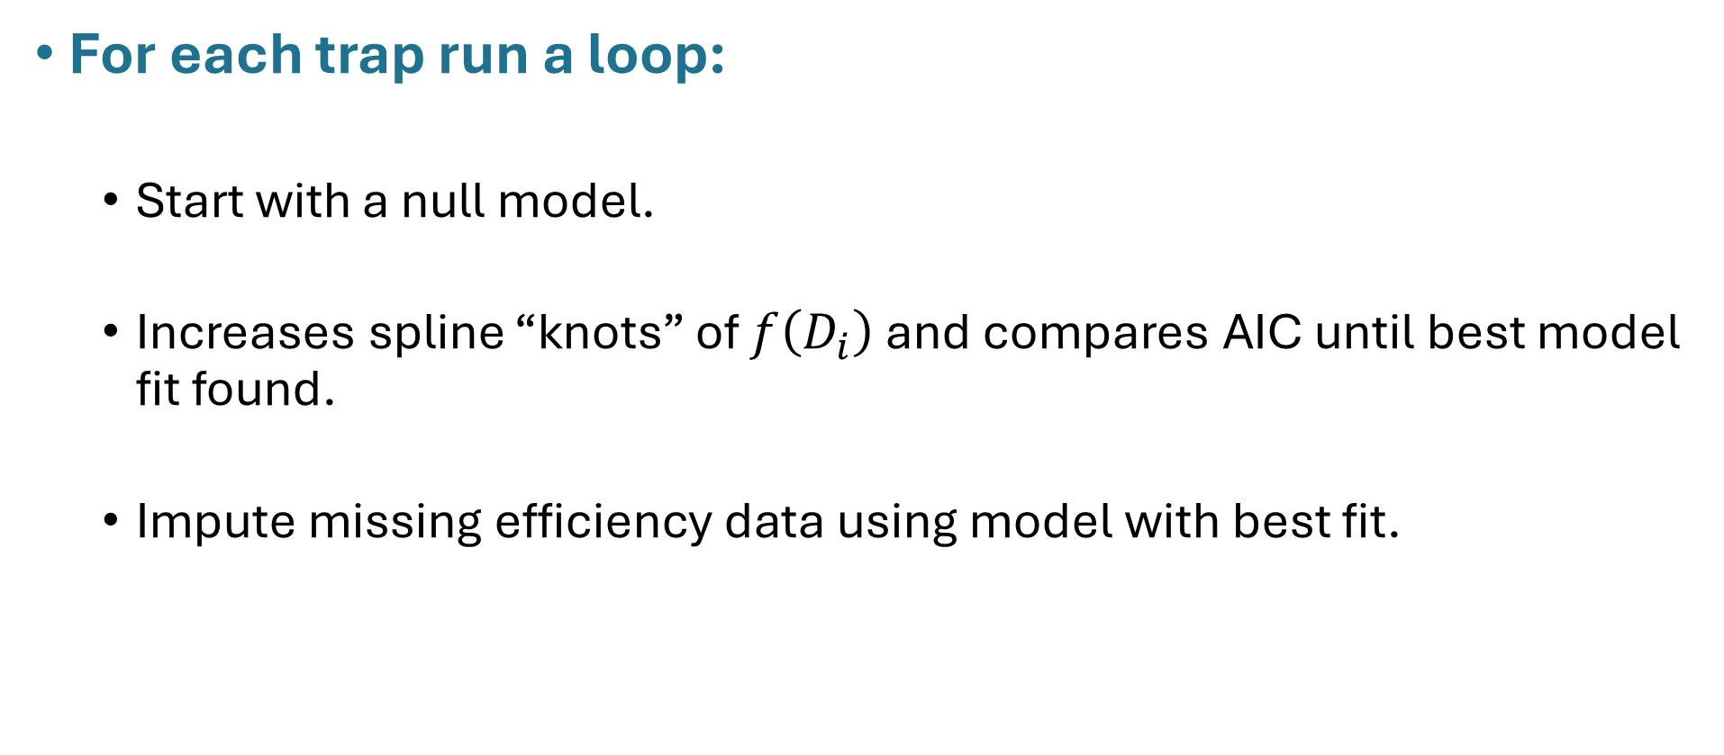
Efficiency model fitting (model_efficiency.R)
For each trap run a loop:
Start with a null model.
Increases spline “knots” of $f\left(D_{i}\right)$ and compares AIC until best model fit found.
Impute missing efficiency data using model with best fit.

Slide 16
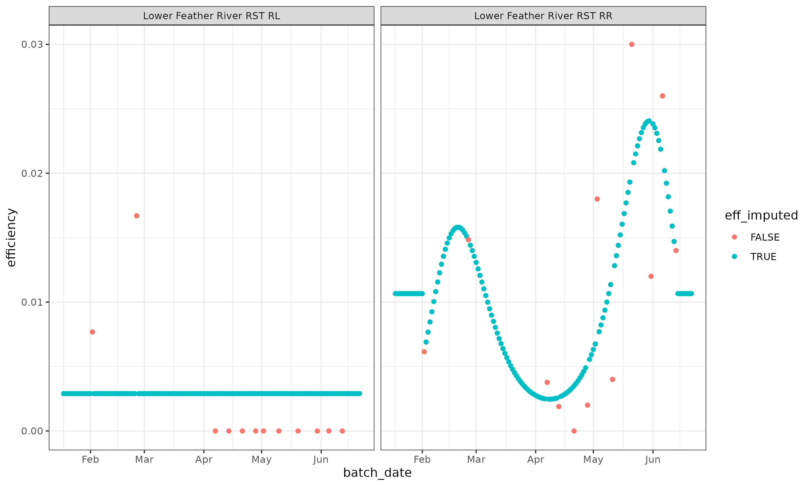

Slide 17

Estimating Passage (est_passage.R)
Runs est_catch() for available catch data and imputes missing values.
Runs est_efficiency for available trial data and imputes for missing periods.
Estimates passage as:
$${\hat{P}}_{t}= \frac{C_{t}}{{\hat{e}}_{t}}$$
${\hat{P}}_{t}$ = estimated total passage for sampling period $t$
$C_{t}$ = total catch for sampling period $t$
${\hat{e}}_{t}$ = estimated trap efficiency for sampling period $t$

Slide 18
Estimating Passage uncertainty (passage_boot.R)
Summarizes passage data by user input (sum.by).
Generates random imputations of catch and efficiency using the overdispersion metrics of catch model and efficiency model fits.
Returns estimates of passage aggregated across traps, with lower and upper CI and the percent of catch imputed per time period.

Slide 19
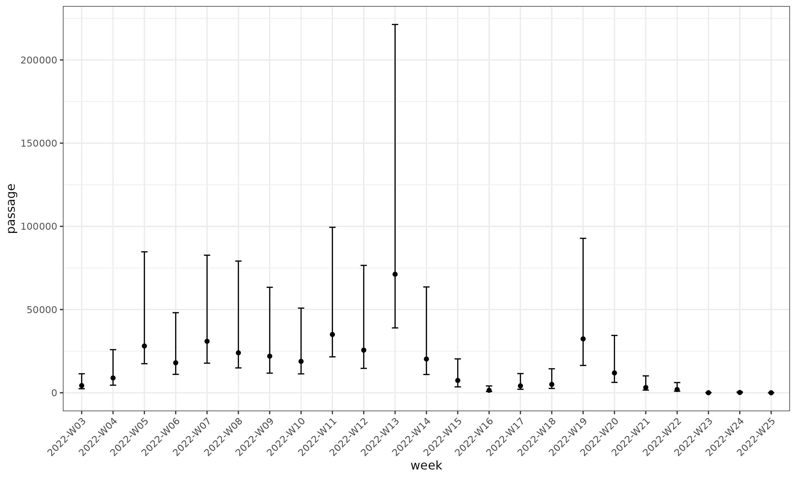
Estimating Passage

Slide 20
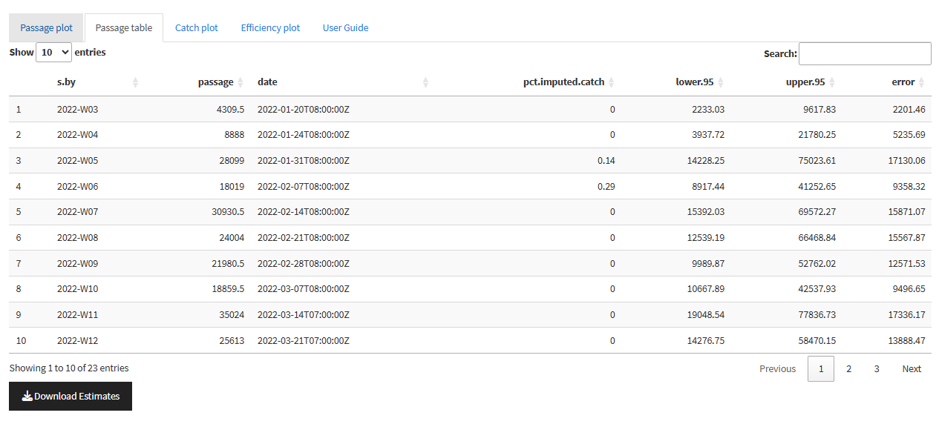
Estimating Passage

Slide 21

New Update: Incorporating discharge
Capture efficiency modeled as a smooth function of date and discharge:
$${Recaptures}_{i}|D_{i},F_{i}\sim Binomial({{released}_{i},e}_{i})$$
Where:
$$\operatorname{logit}\left(e_{i}\right)=β_{0}+β_{1}F_{i}+f\left(D_{i}\right)$$
Discharge scaled

Slide 22
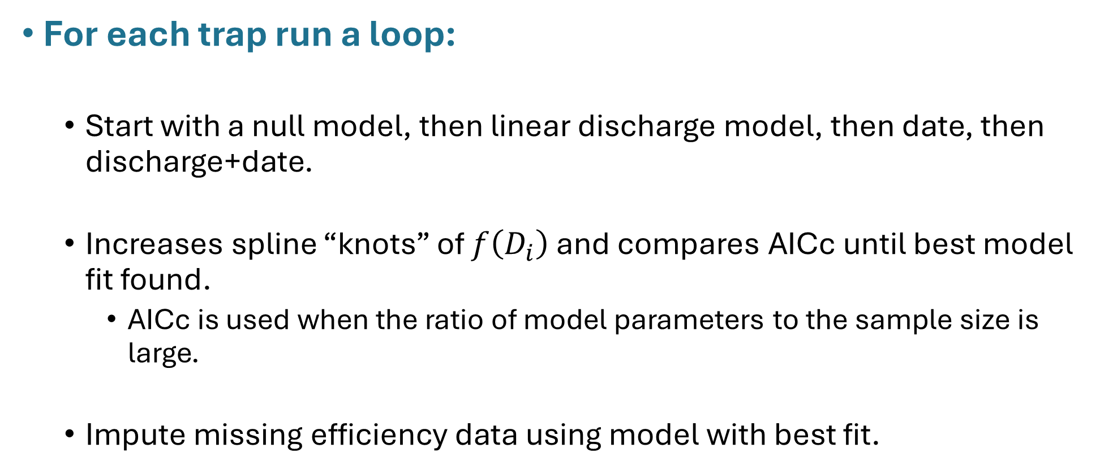
New Update: Incorporating discharge
For each trap run a loop:
Start with a null model, then linear discharge model, then date, then discharge+date.
Increases spline “knots” of $f\left(D_{i}\right)$ and compares AICc until best model fit found.
AICc is used when the ratio of model parameters to the sample size is large.
Impute missing efficiency data using model with best fit.

Slide 23
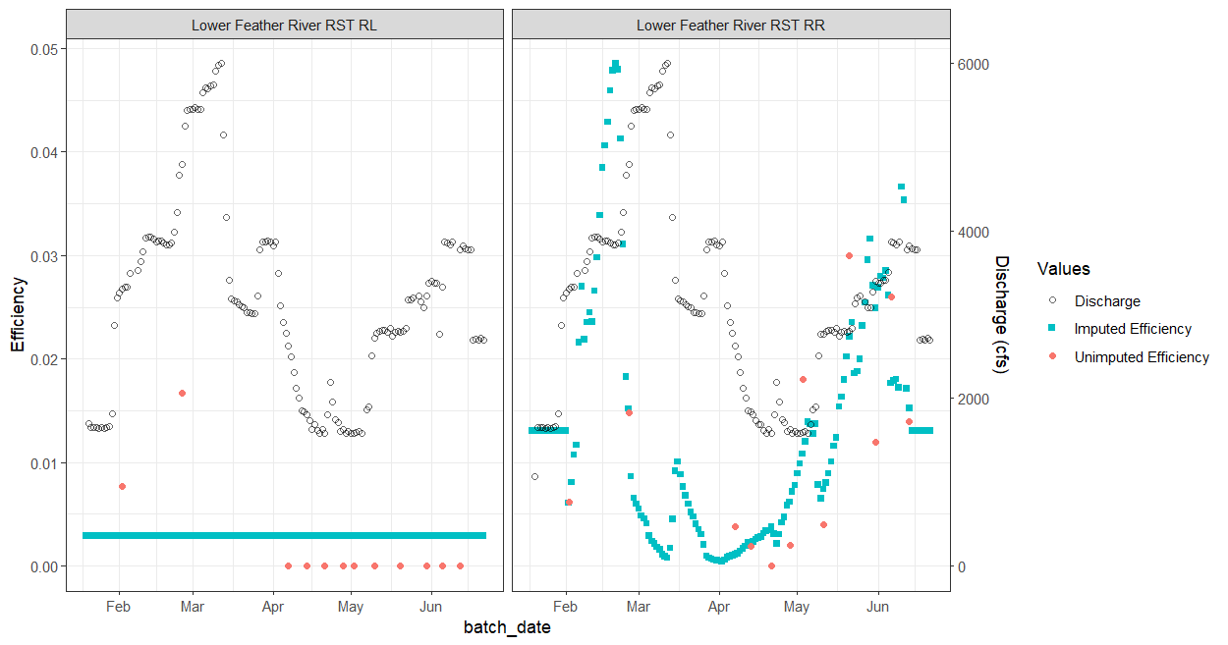
New Update: Incorporating discharge

Slide 24
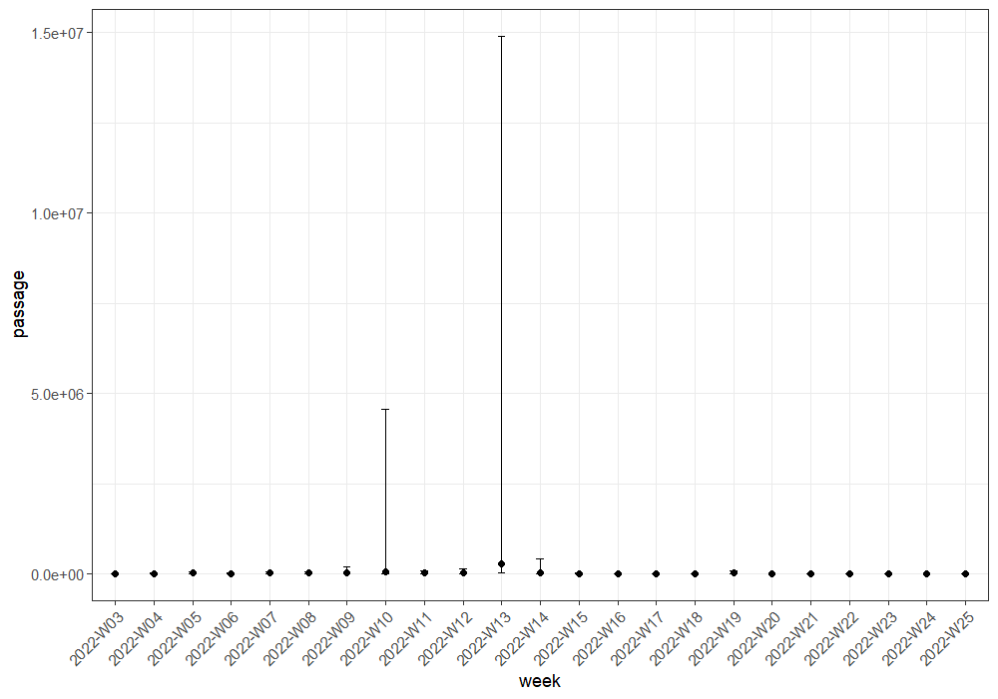
New Update: Incorporating discharge

Slide 25
New Update: Incorporating discharge
Next steps/issues:
Model overfitting: too many parameters, not enough efficiency trials (addressed with AICc).
Model extrapolates efficiency values beyond observed discharge rates.
To do: develop warning flags so user is aware of out of bound estimates.
Allow for user model selection.
Currently application automatically selects best AICc fit.
Updated documentation.

Slide 26
Future updates
Incorporating additional fork length as a covariate.
Incorporate other species estimates.
Reports for model outputs and comparison.
Incorporate DARR-R.
Darroch Analysis with Rank Reduction established by NOAA.
Incorporate Bayesian Time-Stratified Population Analysis Extension (BT-SPAS-X).
Korman et al. 2025
Utilizes efficiency trial data from across years at a given site to inform estimates.

Slide 27
Next steps
replicate CAMPR package
Testing with real and simulated data
Shiny application
Detailed documentation
Initial rollout and user feedback
Continued support and future updates

